Slide 1
BASIC ELECTRONICS
(24B11EC111)
Unit-1
Lecture-3
(Voltage Divider Rule)

Slide 2
CONTENTS
Voltage Divider Rule
Voltage Divider Calculation for two series resistors
Voltage Divider Rule Using more than two Resistor
Practice Problem
Parallel resistors
Current division rule
Numerical
Practice Problems
References

Slide 3
Voltage Divider Rule
Definition
A voltage divider is a basic circuit, used to generate a part of its input voltage like an output. This circuit can be designed with two resistors otherwise any passive components along with a voltage source.
The resistors in the circuit can be connected in series whereas a voltage source is connected across these resistors. This circuit is also called a potential divider.
The input voltage can be transmitted between the two resistors in the circuit so that the division of voltage takes place.

Slide 4
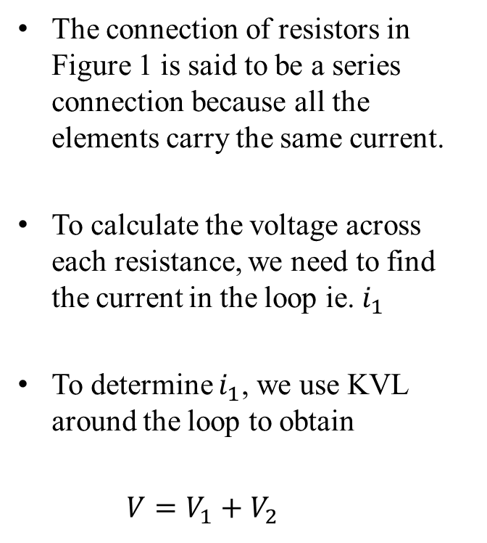
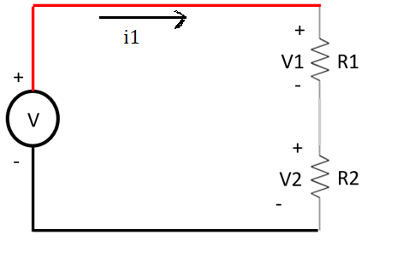
Voltage Divider Calculation for two series resistor
i1
Figure1

Slide 5
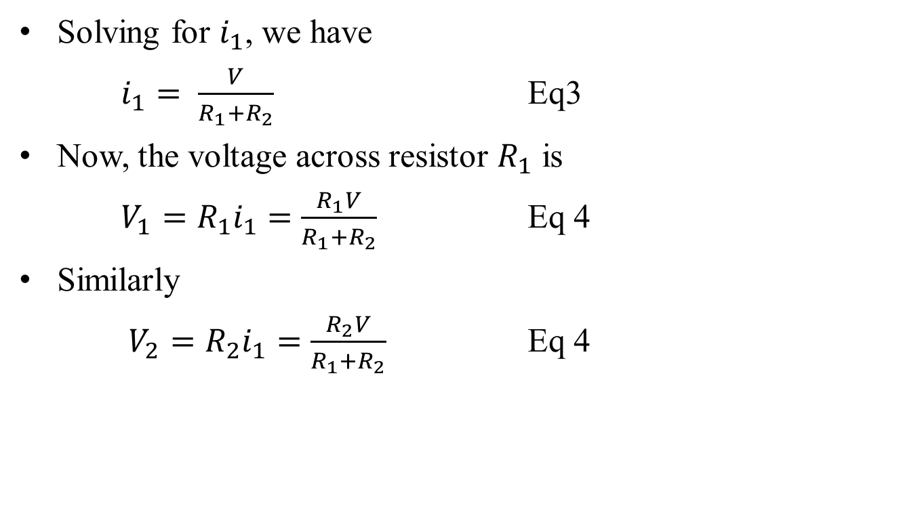
Contd..

Slide 6
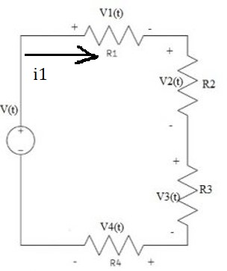
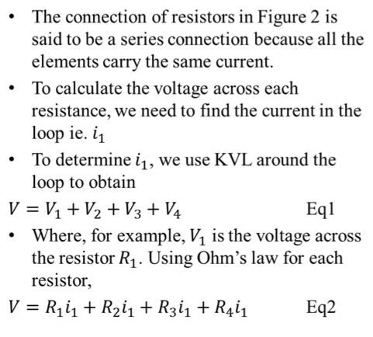
Voltage Divider Rule Using more than two Resistor
Figure 2

Slide 7
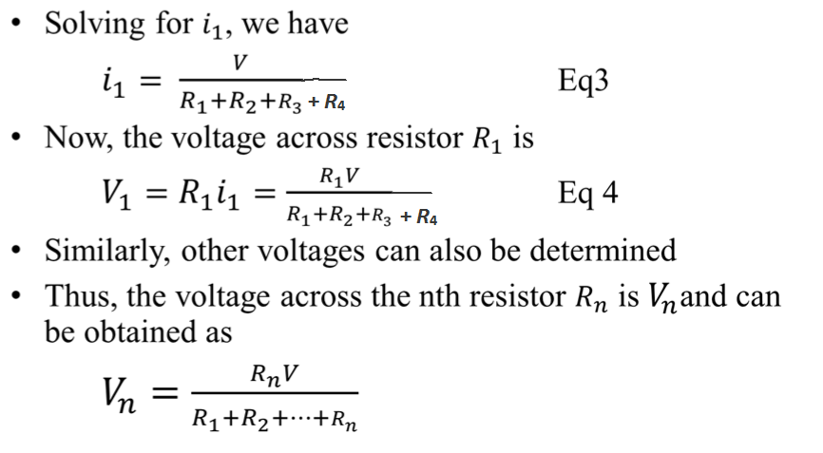
Contd..

Slide 8
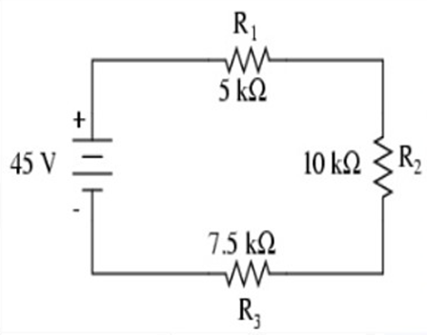
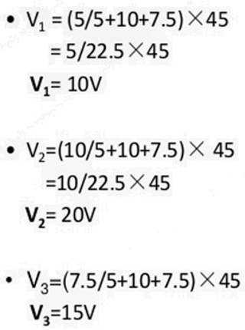
Example-1
Find the voltages across each resisters.

Slide 9
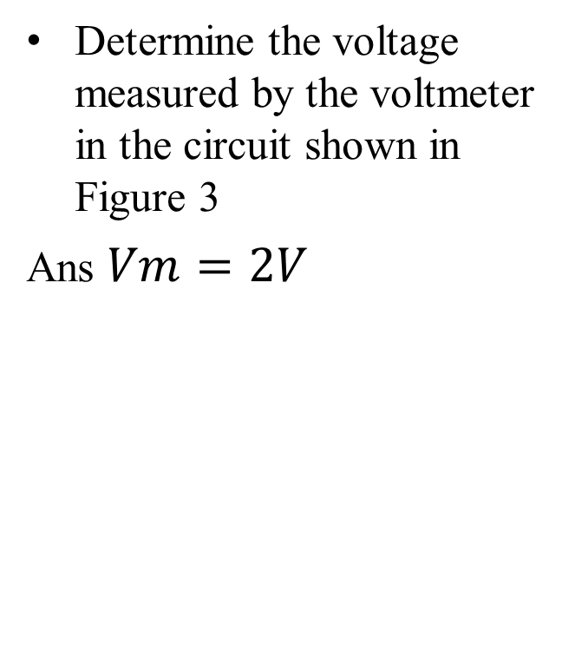
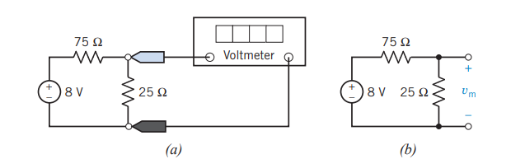
Practice Problem
Figure 3

Slide 10
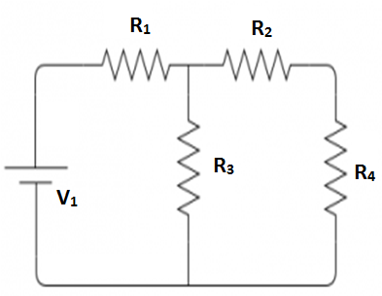
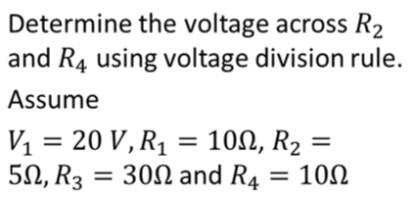
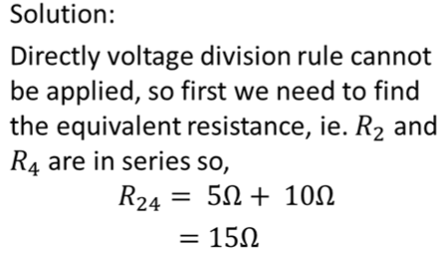
Example 2
Figure 4

Slide 11
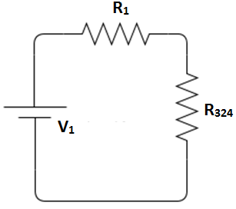
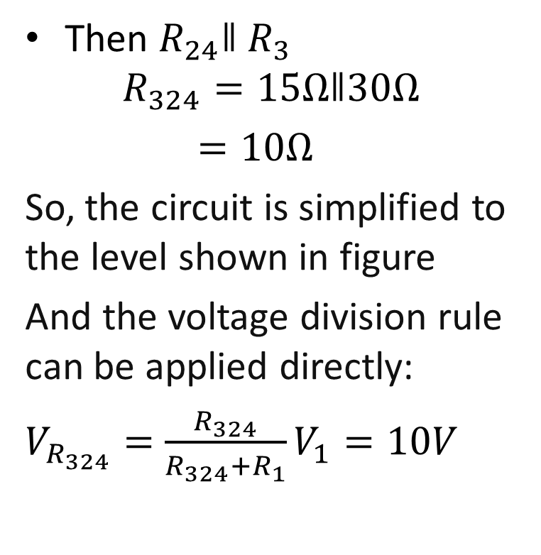
Contd..
Then $R_{24}ǁR_{3}$
$$R_{324}=15Ωǁ30Ω$$
$$=10Ω$$
So, the circuit is simplified to the level shown in figure
And the voltage division rule can be applied directly:
$$V_{R_{324}}=\frac{R_{324}}{R_{324}+R_{1}}V_{1}=10V$$

Slide 12
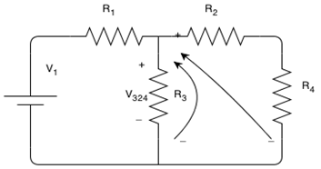
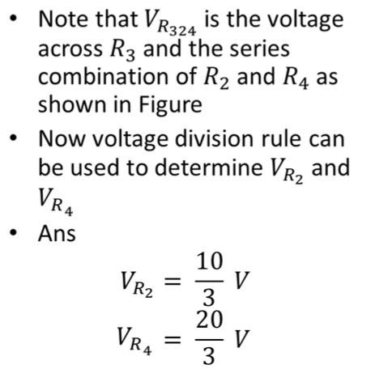
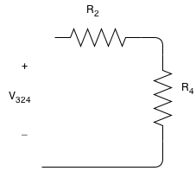
Contd..

Slide 13
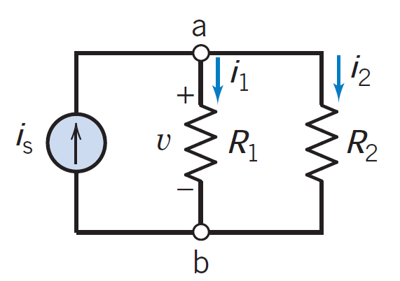
Parallel resistors and Current division rule
The circuit with two resistors and a current source shown in Figure.
Note that both resistors are connected to terminals a and b and that the voltage v appears across each parallel element.

Slide 14
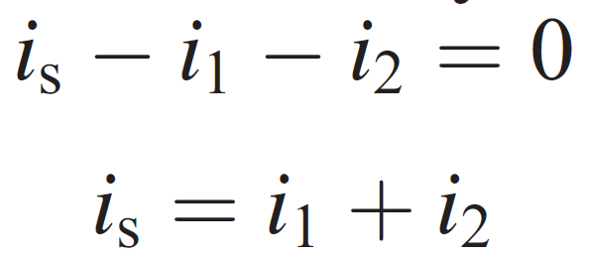
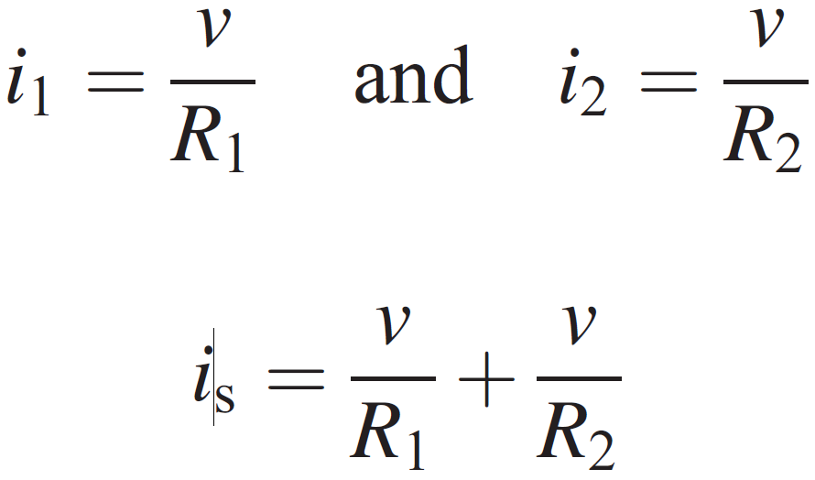
Parallel resistors and Current division rule
KCL at node a
From Ohm’s law

Slide 15

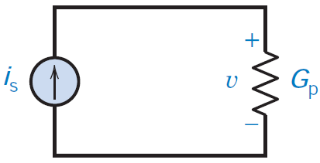

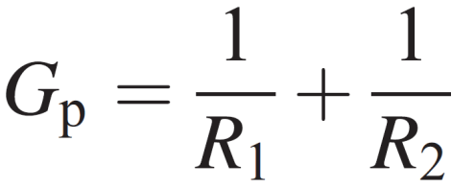
Parallel resistors and Current division rule
Conductance G can be defined as the inverse of resistance R.
Equivalent circuit for this parallel circuit is a conductance Gp, as shown in Figure ,
where
The equivalent resistance for the two-resistor circuit is found from

Slide 16
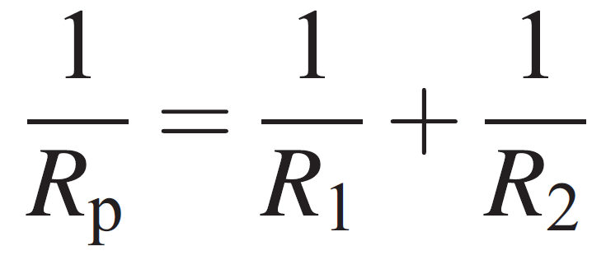
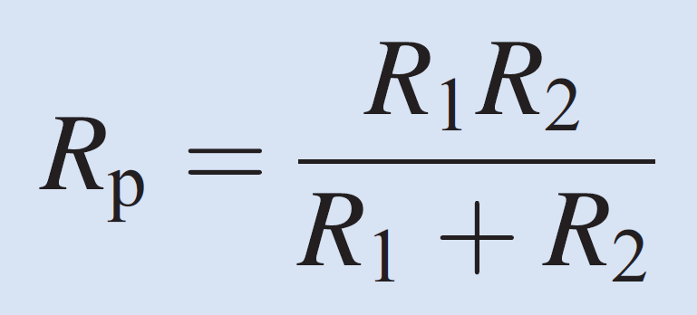
Parallel resistors and Current division rule
Because Gp = 1/Rp, we have
The circuit shown in Figure is called a current divider circuit because it divides the source current.

Slide 17
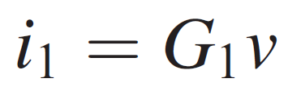

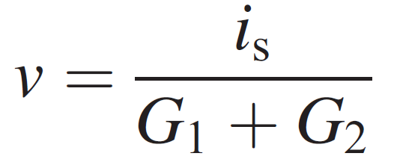
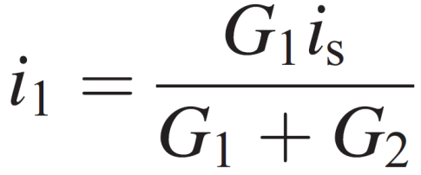
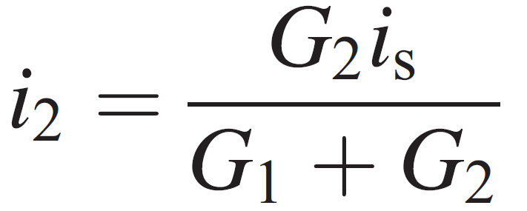
Parallel resistors and Current division rule
Note that
we solve for v, obtaining
Substituting v, we obtain

Slide 18
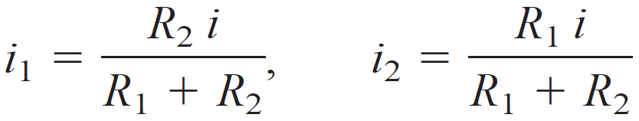
Parallel resistors and Current division rule
Note that we may use G₂ = 1/R₂ and G₁ = 1/R₁ to obtain the current i₁ and i₂ in terms of two resistances as follows:
The current of the source divides between conductances G₁ and G₂ in proportion to their conductance values.

Slide 19
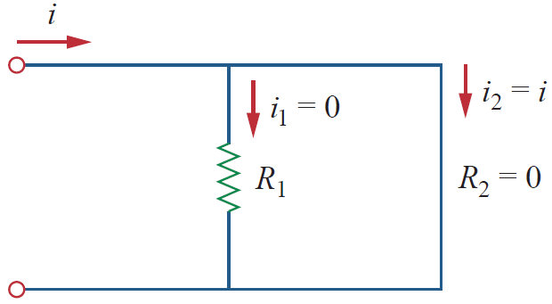
In Fig. 1, suppose one of the resistors is zero, say or short circuit as shown in Fig. 3(a).
From equation (10), implies that , . This means that the current i bypasses and flows through the short circuit , the path of least resistance.
Thus, when a circuit is short circuited, the equivalent resistance,
and the entire current flows through the short circuit.
A shorted circuit

Slide 20
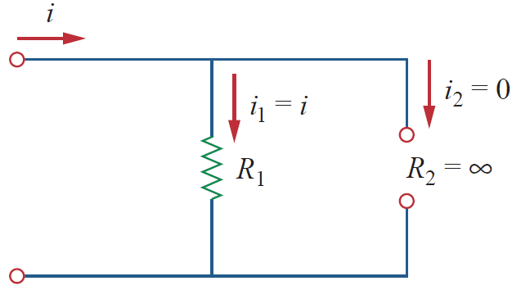
an open circuit
Also, as an another extreme case, suppose or is an open circuit.
The current still flows through the path of least resistance, . By taking the limit of equation (7) as , we obtain in this case.

Slide 21
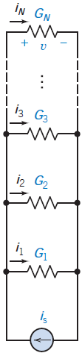
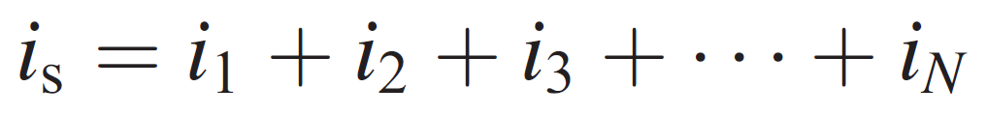


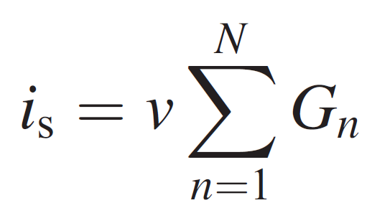
Parallel resistors and Current division rule
Let us consider the more general case of current division with a set of N parallel conductors as shown in Figure.
The KCL gives
---------- Eq. 1
for which
We may write Eq. 1 as
Therefore,
FIGURE Set of N parallel conductances with a current source i_{s}

Slide 22
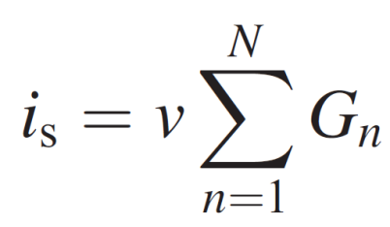
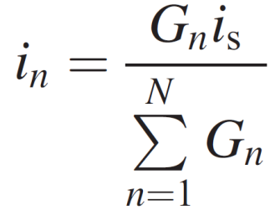
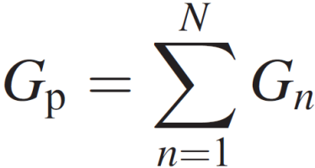
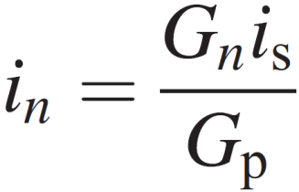
Parallel resistors and Current division rule
Because
we may obtain v from
Equivalent conductance Gp
Therefore,
FIGURE Set of N parallel conductances with a current source i_{s}
which is the basic equation for the current divider with N conductances.

Slide 23
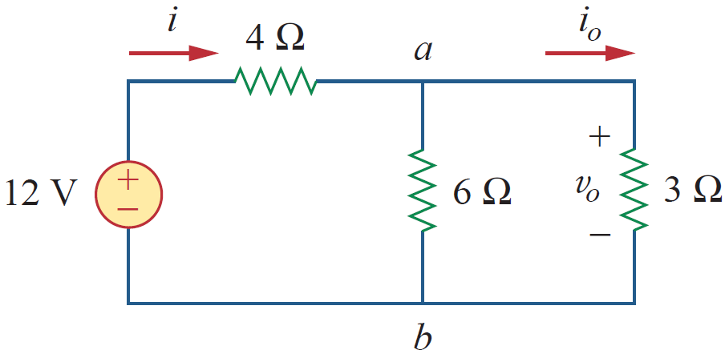
Problems
Problem-1
Find i₀ and v₀ in the circuit shown in Fig. Also, calculate the power dissipated in the 3 Ω resistor.

Slide 24
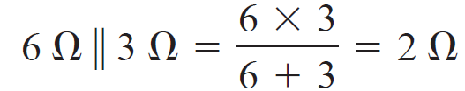
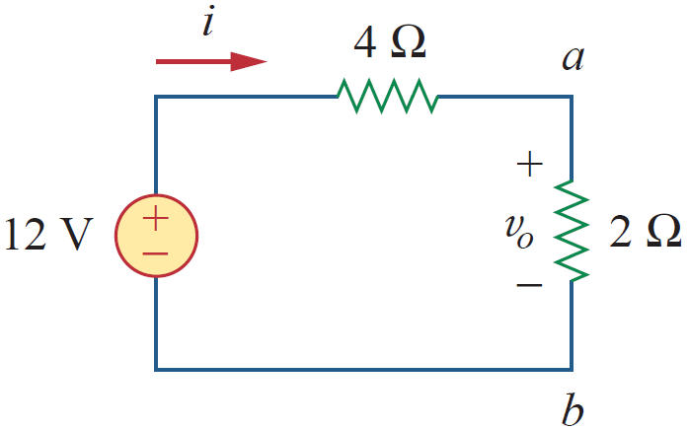
Solution:

Slide 25



Slide 26



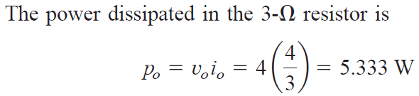

Slide 27
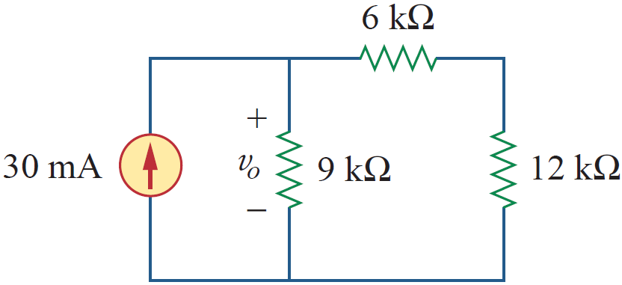
Problem-2
For the circuit shown in Fig., determine the (a) the voltage, v₀ (b) the power supplied by the current source (c) the power absorbed by each resistor.

Slide 28
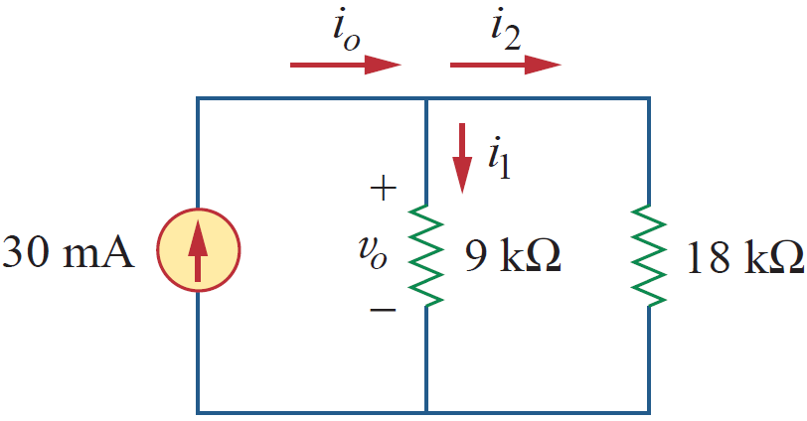
Solution:
(a)
6 kΩ and 12 kΩ resistors are in series,
So 60 + 12 = 18 kΩ
We now apply the current division technique to find i₁ and i₂

Slide 29
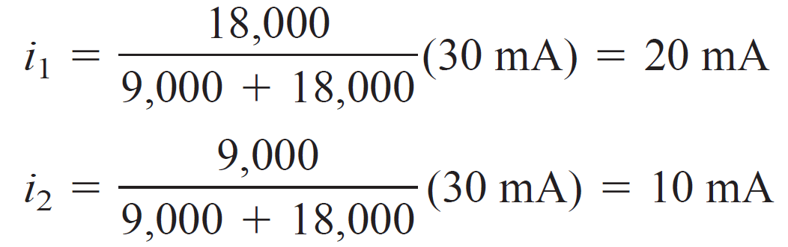
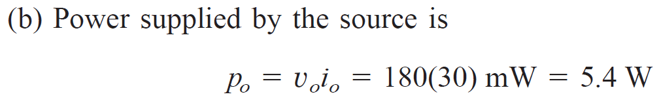

Slide 30
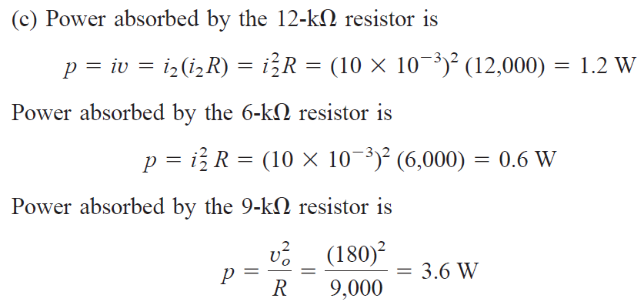
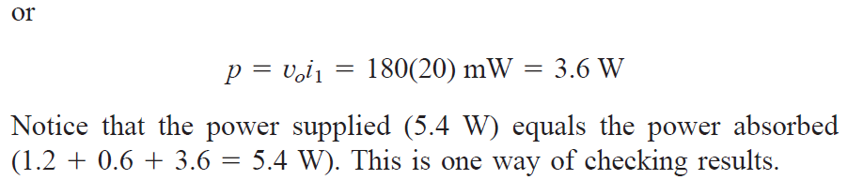

Slide 31
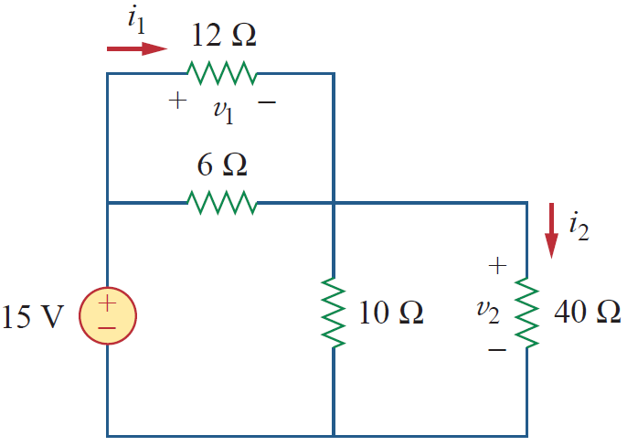
Problems
Find v₁ and v₂ in the circuit shown in Fig. Also, calculate i₁ and i₂ and the power dissipated in the 12 Ω and 40 Ω resistors.

Slide 32

Practice Problems
For the circuit in Figure , find (a) the current in each branch, (b) the equivalent circuit, and (c) the voltage v.
The resistors are R₁ = 1/2 Ω; R₂ = 1/4 Ω; R₃ = 1/8 Ω
Ans: Current i₁ = 4 A, i₂ = 8 A, i₃ = 16 A

Slide 33
References
R.C. Dorf and James A. Svoboda, “Introduction to Electric Circuits”, 9th ed, John Wiley & Sons, 2013.
D.C. Kulshreshtha, Basic Electrical Engineering, Revised 1st ed, Tata Mc Graw Hill, 2017.
V. K.Mehta, Rohit Mehta, Basic Electrical Engineering, 6th ed, S. Chand Publishing, 2012.

